Slide 1
RISK CLASSIFICATION FOR INDIVIDUAL LOAN
BY : STEPHEN JAMES

Slide 2
Objective
Making a machine learning model from the given individual loan dataset to classify loans based on their risk: Low risk or High risk.

Slide 3
About the Dataset
A little Summary of this dataset:
Based on the application type, this is a loan for individual data.
There are 75 features originally.
17 empty features (100% null value).
17 Target Leakage.
Target comes from the loan status feature.
20 features with null values (exclude the 100% empty).
No duplicated rows based on member_id.
21 numerical features (exclude index, id, and member id).
17 categorical features.

Slide 4
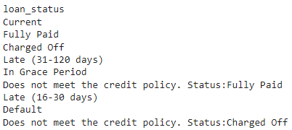
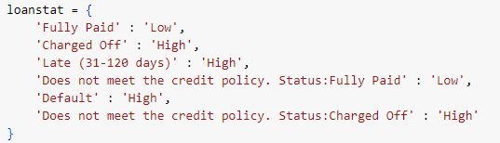
Defining Target
Took the target from the loan status feature:
- Define the target based on the finished loan cycle to make sure that the loan is fully paid to the investor or defaulted. Remove values such as: current, in grace period, and late(16-30 days) because we don’t know whether the borrower could fully pay the loan in the end. Late(31-120 days) is also considered a high-risk loan.
- There are 9 statuses and split into 2 categories, low and high risk:
Low (risk) : Fully Paid, Does not meet the credit policy. Status: Fully Paid
High (risk) : charged off, late(31-120 days), default, Does not meet the credit policy. Status: Charged Off

Slide 5
Target Leakage
Some features will not exist until the customer starts the loan. These features are called target leakage.
To prevent target leakage, any variable updated or created after the target value is realized should be excluded.
Terminologies:
- out_prncp and out_prncp_inv: Principal means the initial size of the loan or amount still owed on a loan.
- total_pymnt and total_pymnt_inv: How much payment the borrower already paid.
- total_rec_prncp, total_rec_int, total_rec_late_fee: Payment received to recorded date (principal, interest, late fee).
- recoveries, collection_recovery_fee: Recovery is the amount of money collected from a loan that continues to go unpaid.
- last_pymnt_d, last_pymnt_amnt, next_pymnt_d, last_credit_pull_d: Date when the borrower pay.
- funded_amnt, funded_amnt_inv: The amount of loan funded by the investor.
- pymnt_plan: Paying off any outstanding debt by means of consolidation into an organized payment schedule.
- issue_d / issue date is also a target leakage but will be removed later since it will be used in feature engineering.

Slide 6
Table of Contents
01
02
Exploratory Data Analysis
Preprocessing
03
04
Consulting
Modelling
Here you could describe the topic of the section

Slide 7
01
Exploratory Data Analysis

Slide 8

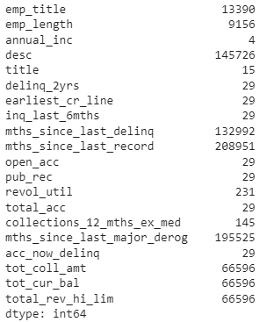


Exploratory Data Analysis
Checking Duplicate
Checking Null Values
Splitting data into numerical and categorical values
Features with null values

Slide 9
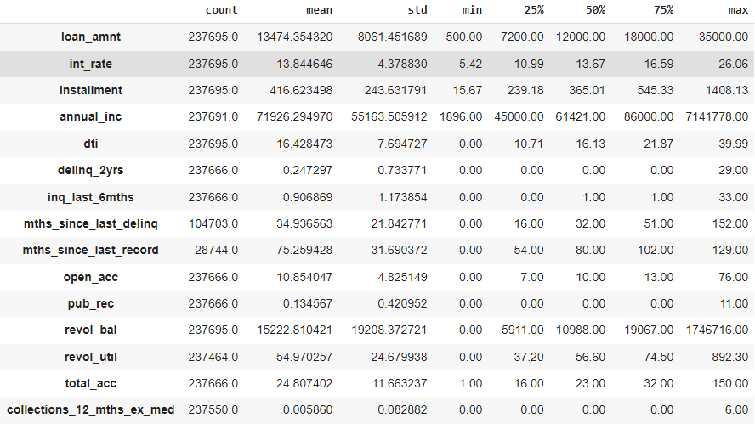

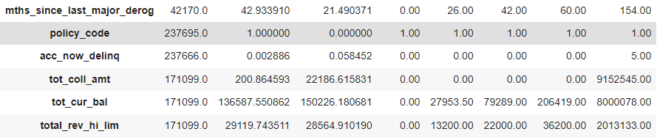
Exploratory Data Analysis (numerical)
Statistical Descriptive

Slide 10
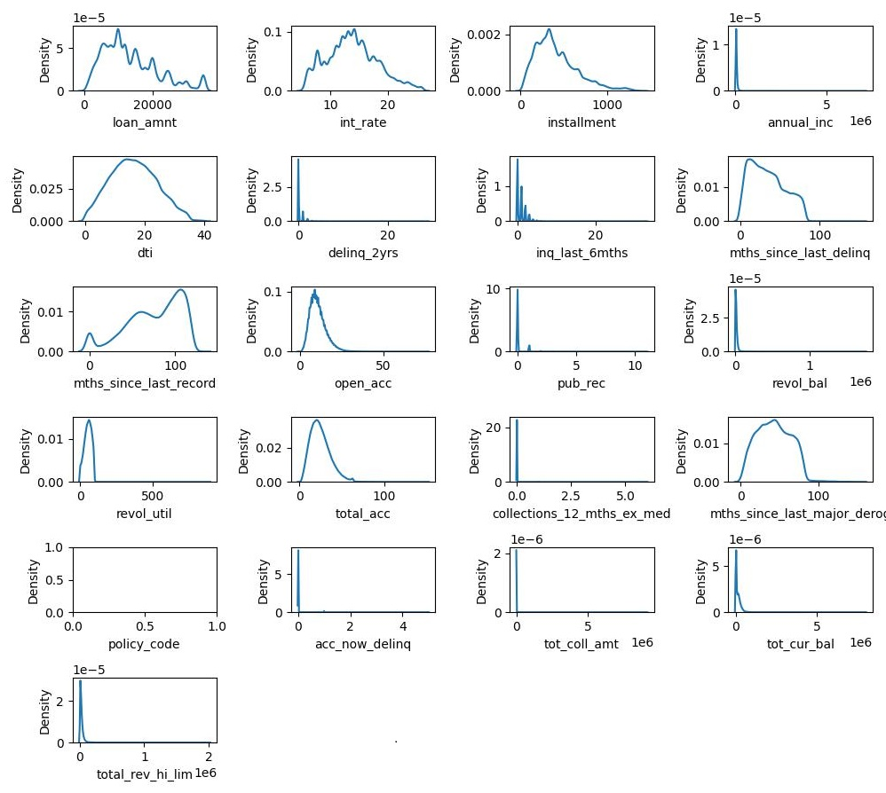
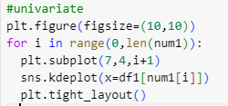
Exploratory Data Analysis (numerical)
Univariate
Numerical features distribution

Slide 11
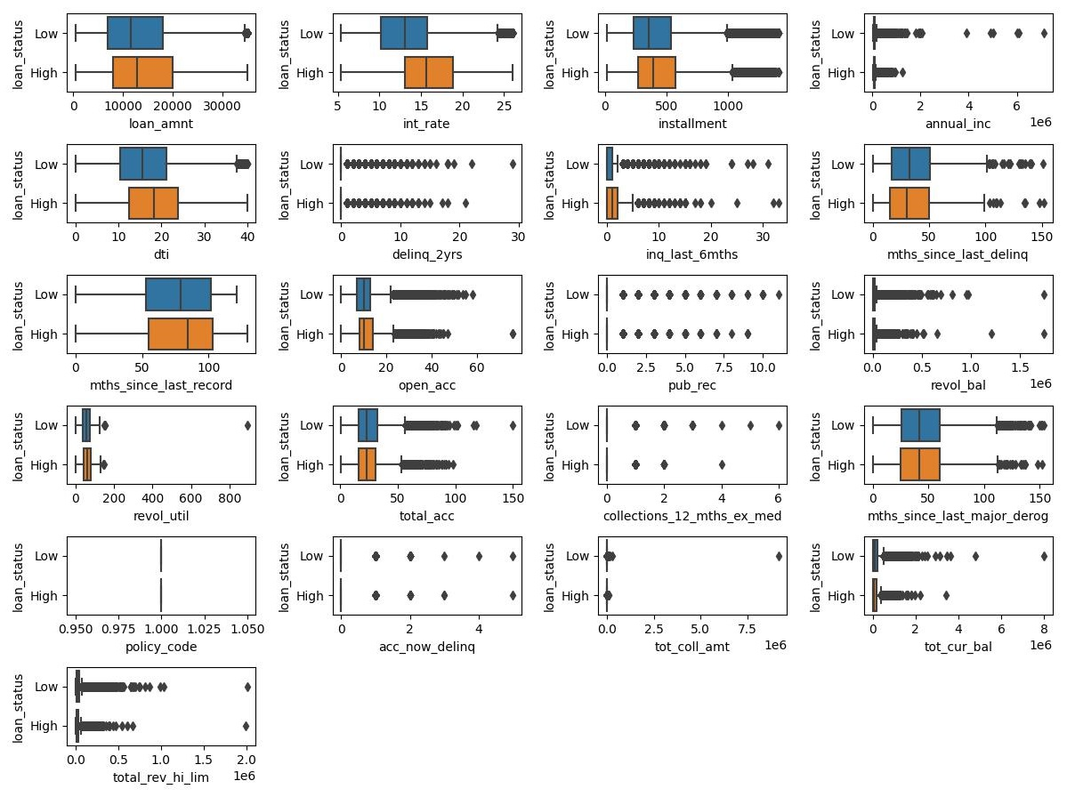
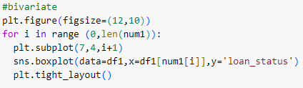
Exploratory Data Analysis (numerical)
Bivariate
Analyzing the correlation between the target and numerical features.
From this boxplot, we could also see that almost all numerical feature has outliers

Slide 12
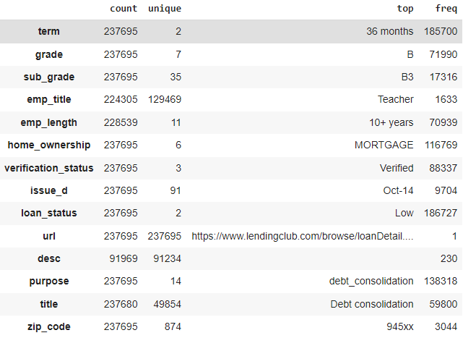

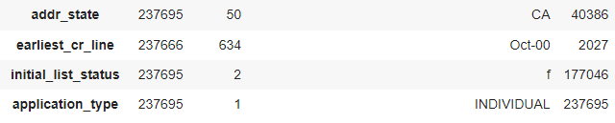
Exploratory Data Analysis (categorical)
Statistical Descriptive

Slide 13
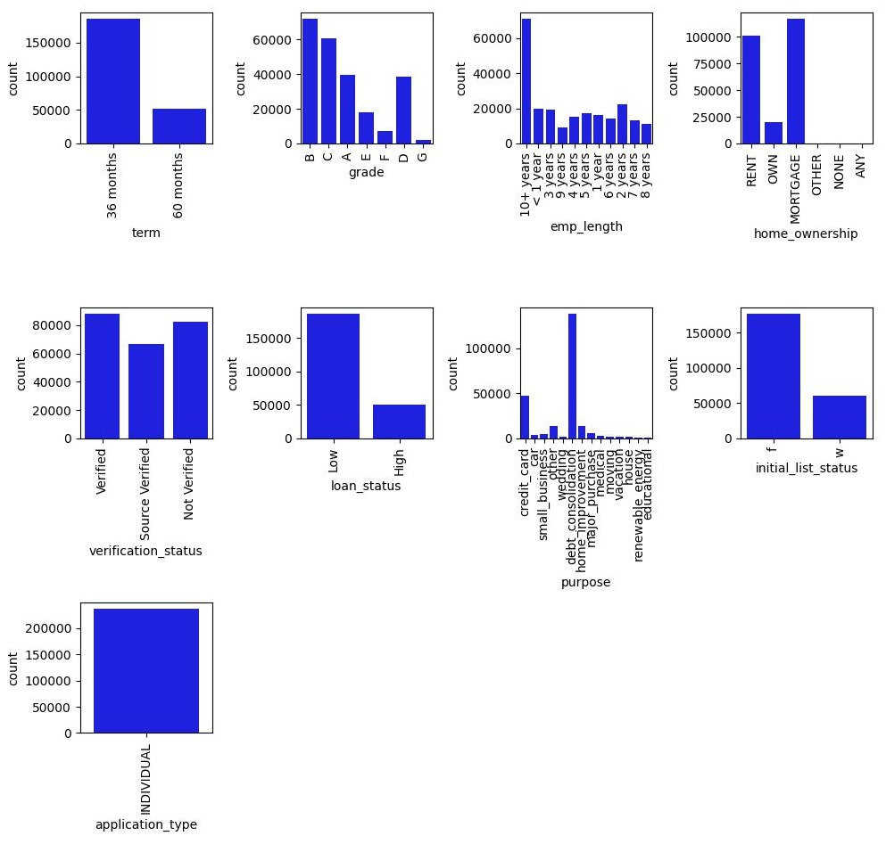

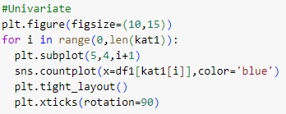
Exploratory Data Analysis (categorical)
Univariate
Categorical features count using countplot for nunique <15

Slide 14
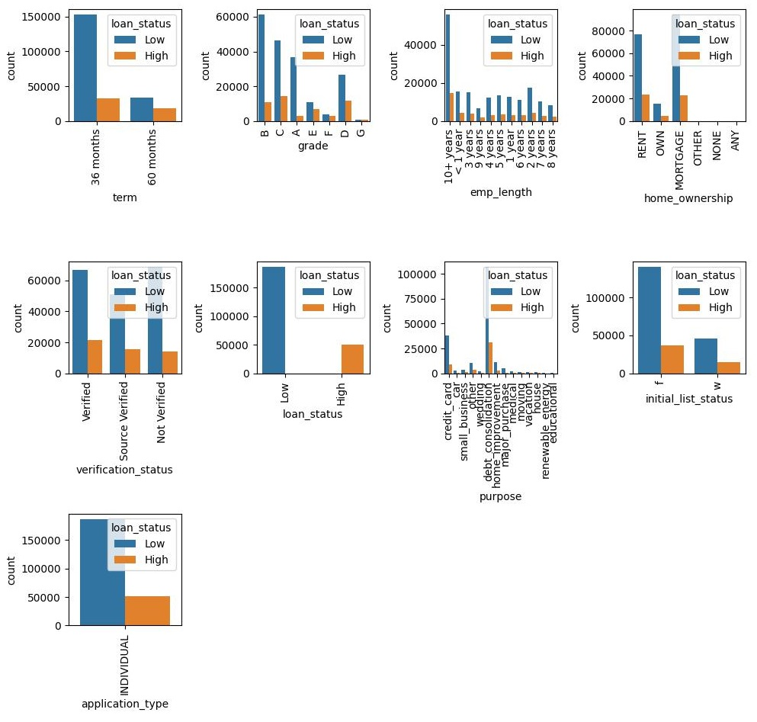
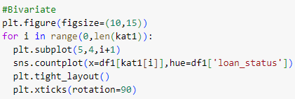
Exploratory Data Analysis (categorical)
Bivariate
Analyzing the correlation between the target and categorical features

Slide 15
02
Preprocessing

Slide 16


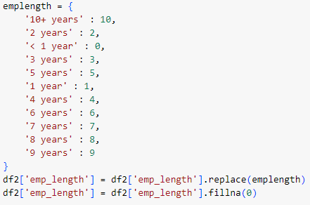
Preprocessing
Unnecesary Columns
Handle missing value (1):
- Remove null value higher than 50%
- Fill missing emp_length value with zero
policy_code and application_type: only has 1 unique value
sub_grade: already represented by grade
emp_title, url, desc, title, zip_code, addr_state: too much unique values

Slide 17
Handle Missing Values (2)
- Fill some features with median
- Removing rows with missing value

Slide 18
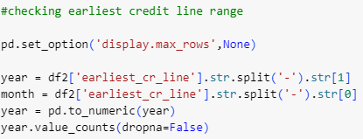
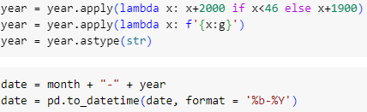
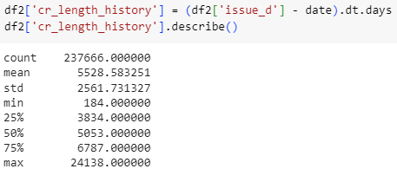
Feature Engineering
Creating new features: Credit length history
Time deficit from earliest credit line to issue date.
In this dataset, the issue date should be a target leakage, but I will use it assuming that the issued date time will not be far away from the time borrower applying for the loan. Later, the issue date and earliest credit line features will be dropped.
Function to get the correct year
- Checking the earliest credit manually because when it converted to DateTime, the year below 1969 automatically converted to 2068, etc.
- Turns out that the earliest credit is from 1946.

Slide 19

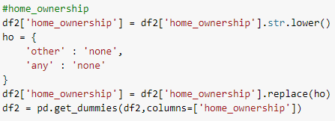
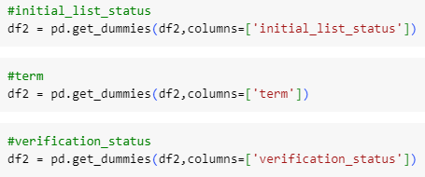
Feature Transformation
One hot encoding:
- purpose
Grouping other purposes besides debt consolidation and credit card since they have the most count.
- home ownership
Moved other and any values in home ownership into none because they have a very low count compared to other.
- initial list status, term, and verification status

Slide 20
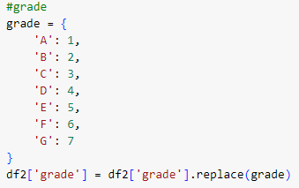
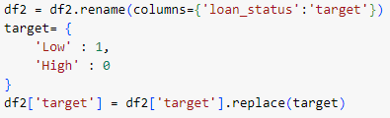
Feature Transformation
Label encoding:
- grade
Changed from A to G became 1 to 7.
- target
Changed low risk to 1 and high risk to 0

Slide 21
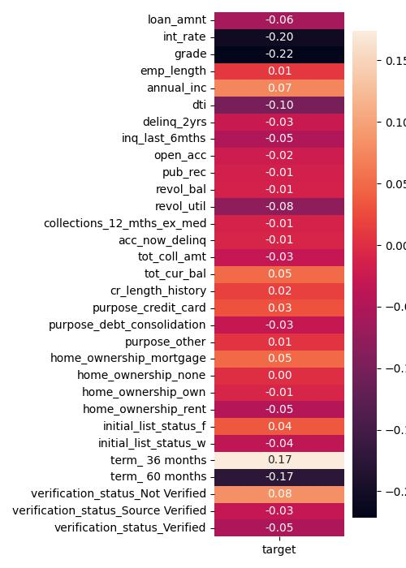
Feature Selection
Based on the correlation heatmap, I will remove features that:
Redundant
Two features with high correlation to each other (initial list status, term 36 months, int rate)
Low correlation
Features with low correlation with target (emp length, pub rec, revol bal, collection 12 mhts ex med, acc now delinq, purpose other, home ownership none, home ownership own)
Grade
Decided to remove grade features as that feature is really deciding the result. Wanted to see the impact of other features without the grade feature

Slide 22
03
Modelling

Slide 23
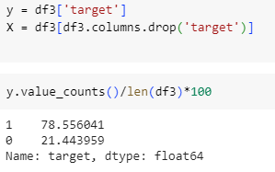
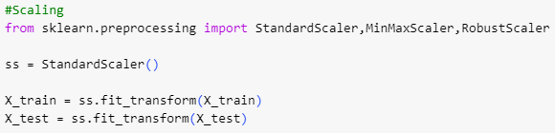
Modelling
Split into 2 variable, target (y) and features (X)
Train test split
Scaling with standardization

Slide 24
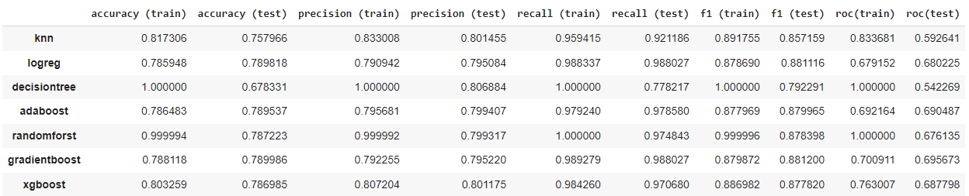
Modelling
Machine learning
Fit some models into the dataset and this is the result:
From this credit risk classification, F1 is used as a metrics evaluation in order to minimalized false positive. Investor doesn’t want a loan that is indicated as a low risk loan but in the end, the borrower defaults and investor ended up losing money. Based on that, logistic regression and Adaboost used.

Slide 25
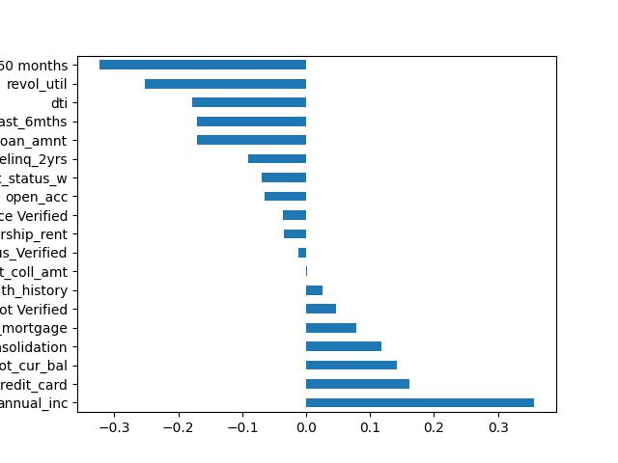
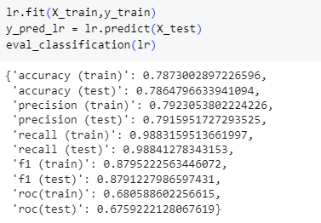

Modelling
Feature Importance
Logistic Regression
From this model, F1 Score resulted in 0,88 for test and train data
From feature importance, we could see that annual income becomes the most important feature that would make a borrower paid their loan. 5 years term and revolving utilization rate play a big role in defaulted loan.

Slide 26
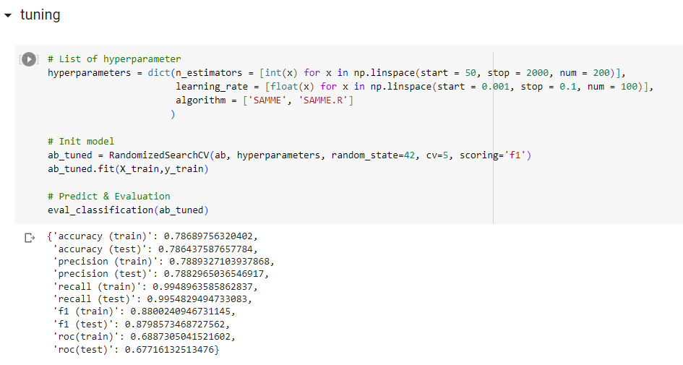
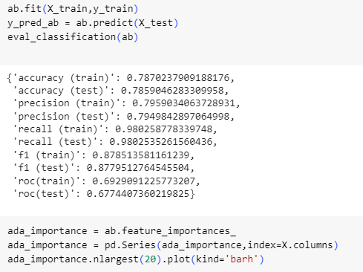
Modelling
Adaboost
F1 resulted in 0,87 before and after tuning.

Slide 27
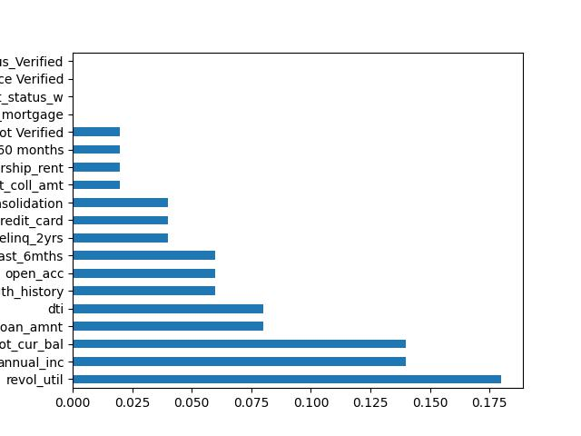
Modelling
Adaboost
Feature importance
Revolving utilization rate, annual income, and total current balance have the most influence on AdaBoost results.

Slide 28
Conclusion
From both models used logistic regression and adaboost, the F1 score are quite the same about 0,87-0,88.
Revolving utilization rate and annual income appeared in both models’ feature importances. Showing that these two features play an important role in classifying loan risk.

Slide 29
Thanks
Created by: Stephen James
Ign.james4@gmail.com
https://www.linkedin.com/in/stephenjames123/

